Slide 1
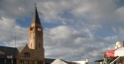
Plant Sale Plants 2013 Trees and Shrubs

Slide 2
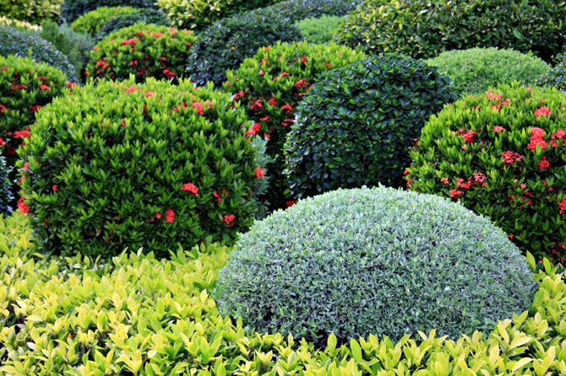
Shrubs, Bushes, and Vines

Slide 3
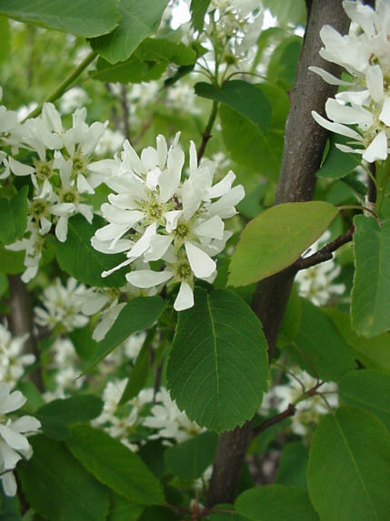
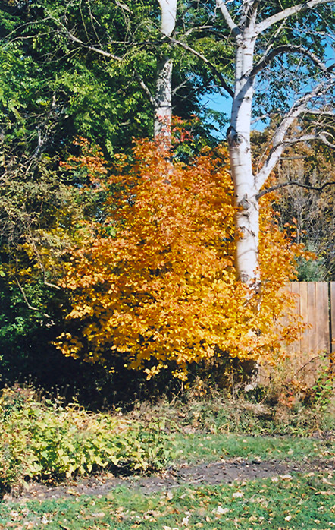
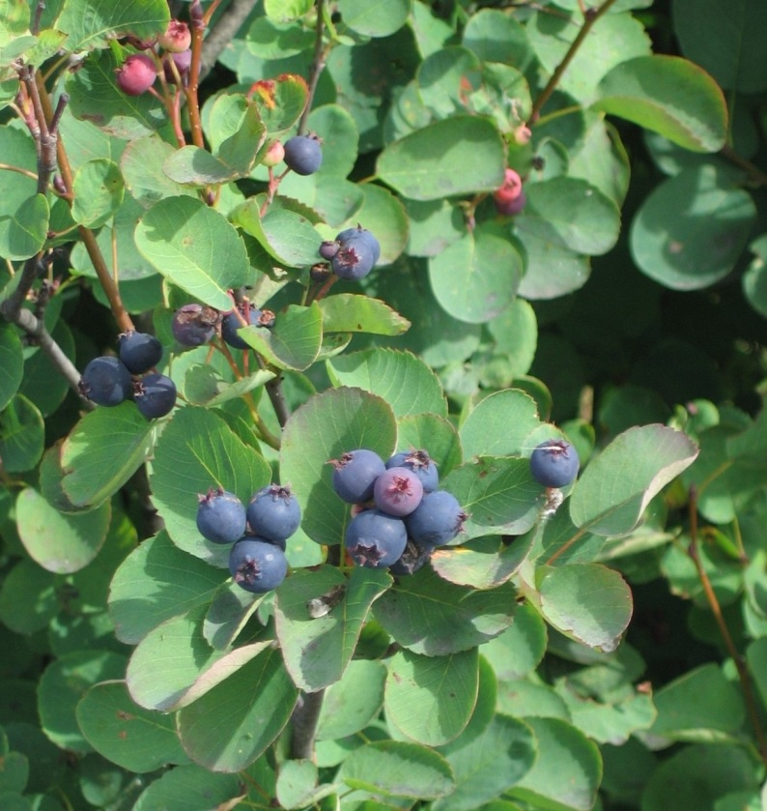
Saskatoon Serviceberry, Juneberry Amelanchier alnifolia Multi-stemmed shrub with clusters of small, fragrant white flowers in spring. Oval leaves turn gold and soft red in fall. Small, purple-black edible fruits in mid-summer. Mature Height: 6-15’ Mature Spread: 8’ Exposure: Sun to part shade Water Requirements: Moderate

Slide 4
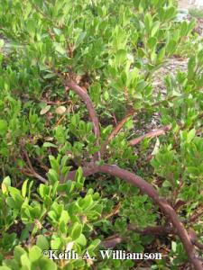
‘Panchito’ Manzanita Arctostahylos x coloradoensis "Panchito“ Evergreen groundcover with shiny, oval dark green leaves on mahogany-red branches. Urn-shaped, pale pink flowers are followed by small red berries. Will cascade down walls and over boulders. Mature Height: 10-15” Mature Spread: 3-5’ Exposure: Sun to Filtered Shade Water Requirements: Low once established. Excellent drainage required.

Slide 5
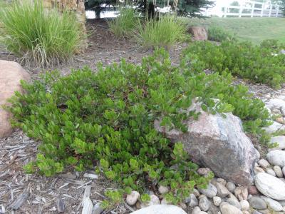
‘Chieftain’ Manzanita Arctostahylos x coloradoensis “Chieftain“ Evergreen shrub with shiny, oval dark green leaves on mahogany-red branches. Urn-shaped, pale pink flowers are followed by small red berries. A large shrub, up to 4’ tall and 6’ wide. Mature Height: 18-36” Mature Spread: 5-8’ Exposure: Sun to Filtered Shade Water Requirements: Low once established. Excellent drainage required.

Slide 6
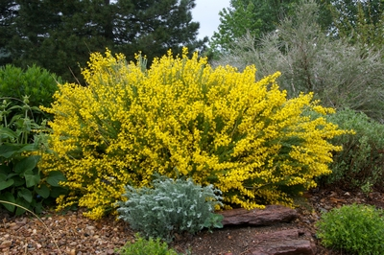
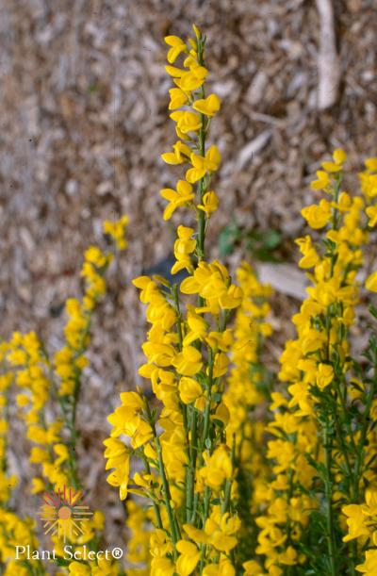
Spanish Gold Broom Cytisus purgans "Spanish Gold" A dense mound of fine, twiggy stems with tiny leaves. Covered with deep gold, pea-like flowers in spring. Leaves drop soon after bloom, stems stay green all year. Mature Height: 2-4’ Mature Spread: 6’ Exposure: Sun Water Requirements: Low

Slide 7
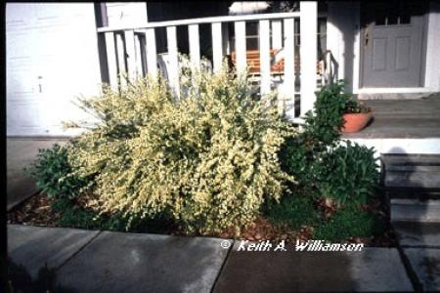
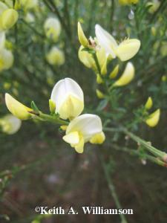
“Moonlight” Scotch Broom Cytisus scoparius "Moonlight" A rounded shrub with slender, nodding green branches with tiny leaves. Covered with profuse creamy yellow pea-like flowers in late spring. Leaves will drop by mid-summer, but the twigs remain green all year. Mature Height: 4-6’ Mature Spread: 4-6’ Exposure: Sun Water Requirements: Low

Slide 8
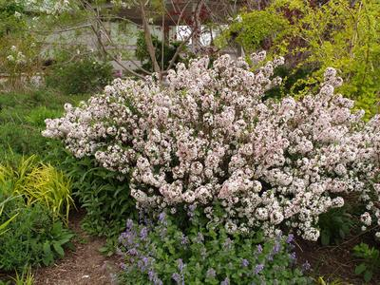
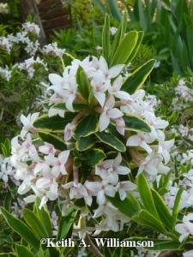
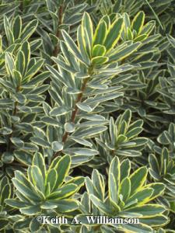
Variegated Daphne Daphne x burkwoodi "Carol Mackie" Rich green leaves with creamy yellow margins on a densely branched rounded shrub. Clusters of tubular, white to soft pink flowers with an intoxicating fragrance in Spring. Mature Height: 3-5’ Mature Spread: 3-5’ Exposure: Shade to part shade Water Requirements: Moderate

Slide 9
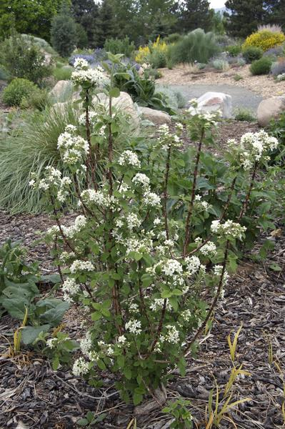
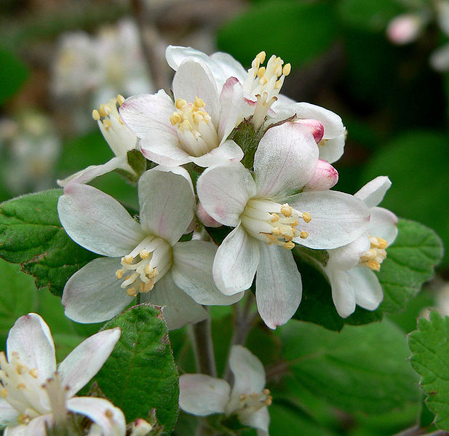
Waxflower Jamesia americana A flat-topped shrub with upright, spreading branches and flaky reddish-brown bark. Bright green, distinctly veined leaves with a downy white underside turn reddish in fall. Large, waxy, fragrant, white flowers in Spring. Mature Height: 5-8’ Mature Spread: 3-6’ Exposure: Shade to part shade Water Requirements: Low

Slide 10
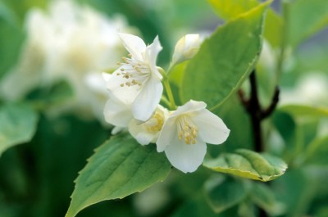
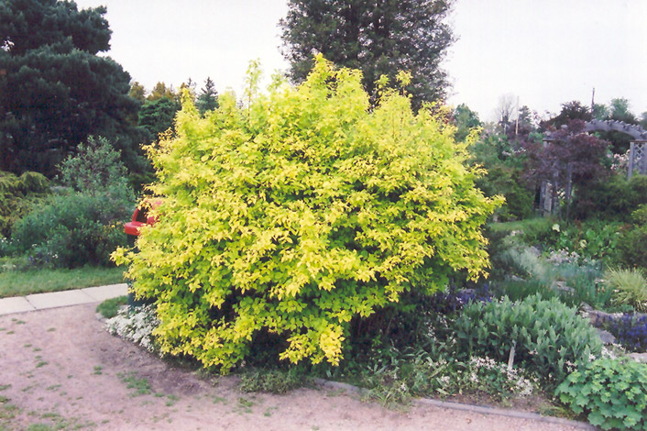
Golden Mockorange Philadelphus coronaries ‘Aureus’ A golden leaf shrub with fragrant, single white flowers in June and a nice compact form. Zones 4-8 Mature Size: 3-6’H x 4-5’

Slide 11
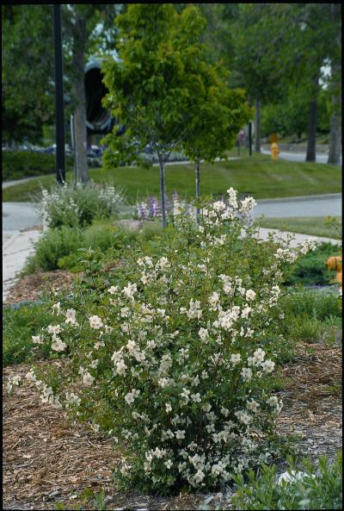
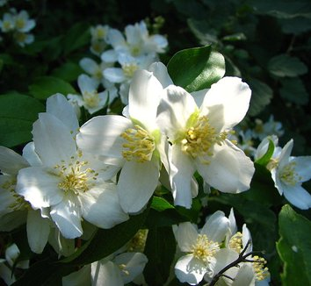
Cheyenne Mockorange Philadelphus lewisii "Cheyenne" Large, single white blossoms with a heady orange-blossom scent. Forms a loose, upright to rounded shrub. Variety developed at the Cheyenne Horticultural Station. Mature Height: 5-7’ Mature Spread: 4-6’ Exposure: Sun Water Requirements: Low

Slide 12
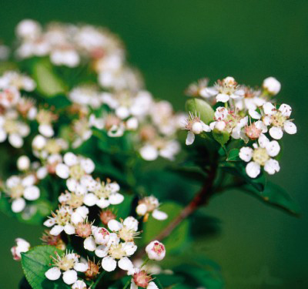
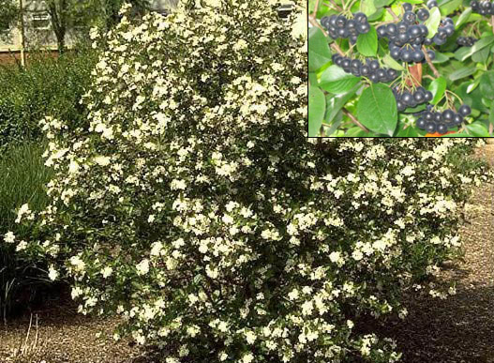
Autumn Magic Black Chokeberry Aronia melanocarpa ‘Autumn Magic’ A beautiful cultivar from the University of British Columbia. Fragrant white flowers bloom in May followed by clusters of large, edible, dark purple-black berries which persist through the season. The leaves are a dark, glossy green all season long and put on an incredible fall color show of red and purple. Does well in full sun to part shade and is tolerant of most soil types. Aronia berries can be eaten fresh, used for baking, jams, juice and wine. Zones 3-7 Mature Size: 3-5’ x 2-4’

Slide 13
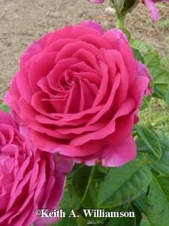
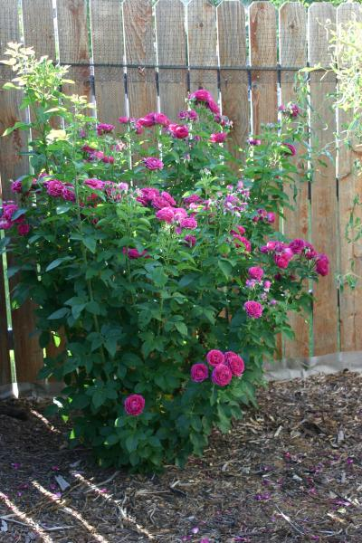
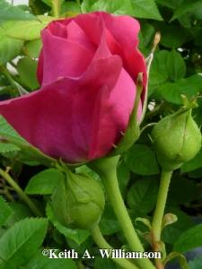
“Ruby Voodoo” Rose Rosa "Ruby Voodoo" A repeat blooming, centiflora-type rose with highly fragrant, fuschia blossoms in early summer, with repeat bloom in fall. Upright habit with strong canes. Noted for minimal winter cane dieback. Mature Height: 6-8’ Mature Spread: 5-6’ Exposure: Sun Water Requirements: Low

Slide 14
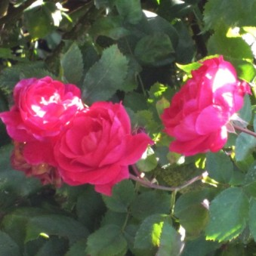
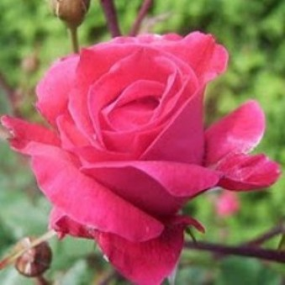
Alexander MacKenzie Shrub (Explorer, 1985). Cup-shaped, double, medium-red blooms are born in clusters of 6 to 12. Recurrent bloom cycle. Glossy foliage has good disease resistance. Growth is upright, reaching 6 feet tall by 4 feet wide.

Slide 15
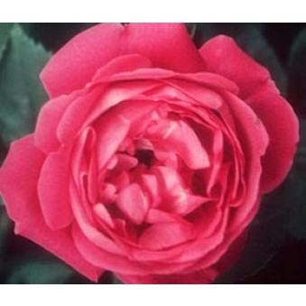
American Beauty, Climbing (Hoopes & Thomas, 1909). Fragrant double blooms are large, cupped and deep, rose pink. It is remarkably hardy and tolerant of shade. It can reach a height of 12-14 feet if trained on a trellis or wall.

Slide 16
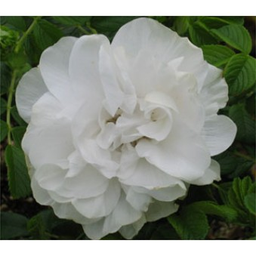
Blanc Double de Coubert Hybrid Rugosa (Cochet-Cochet, 1892). This tough rose has wonderfully fragrant, full white blooms in midseason with good repeat, with orange hips. Dark green foliage that colors well in autumn on a bush 5-6’ tall and wide.

Slide 17
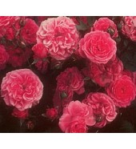
Elmshorn Shrub (Kordes, 1951). Huge clusters of small, cherry-red, double flowers bloom throughout the summer and into fall. Glossy green leaves on an upright shrub reaching 4 to 6 feet in height. Tolerant of poor soil and tough conditions.

Slide 18
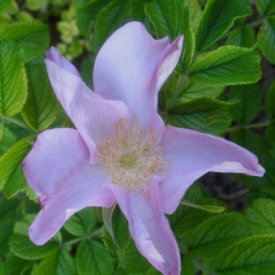
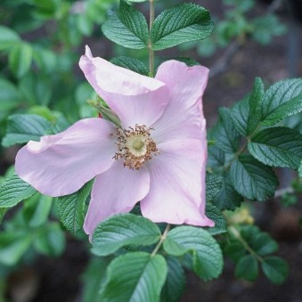
Frau Dagmar Hartopp Hybrid Rugosa (Hastrup, Denmark, 1914). Lovely pink, single, 3-inch blooms cover this low-growing shrub repeatedly from spring to fall. Foliage is dark, glossy green with outstanding fall color, offsetting large red hips nicely. Height and width 4 feet.

Slide 19
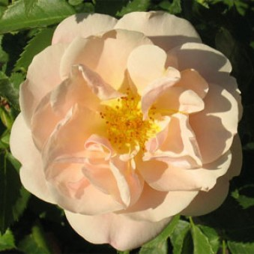
Goldbusch Shrub (Kordes, 1954). Coral colored buds open to double (24-30 petals), peach-yellow fragrant blooms, with good repeat and large hips. A low, spreading bush that reaches 5 feet high and wide.

Slide 20
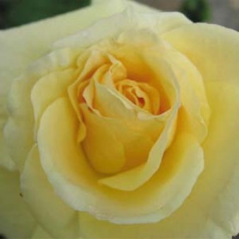
J. P. Connell Shrub (Explorer Series,1987). Fragrant, pale yellow double flowers begin with hybrid tea form, then open to expose the stamens. June flowering with some repeat bloom throughout the season. Vigorous upright shrub growing 3 to 5 feet tall and wide.

Slide 21
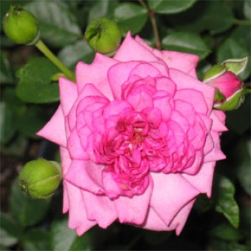
Lavender Jewel Miniature (Moore, 1978). Shapely, high centered lavender-mauve blooms cover this compact bush all summer long. Dark glossy green foliage is disease resistant. Height 18 to 24 inches.

Slide 22
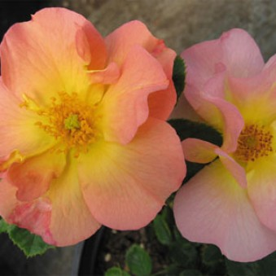
Morden Sunrise (PP13,969) (Parkland Series, Davidson,1999). Fragrant, semi-double blooms are held in trusses of up to 15 flowers, opening orange, aging to bright yellow and finally creamy white. A low-growing, hardy shrub with upright canes and glossy, deep green foliage. Height and width 2 to 3 feet.

Slide 23
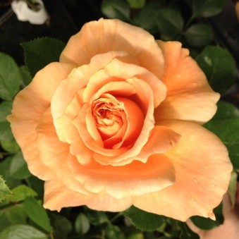
Prairie Sunrise Shrub (Buck, 1997). Lush, fragrant, apricot blooms are very full with petals in a quartered pattern. Blooms abundantly all season on a compact bush 3 feet tall and wide. Large, medium green leaves are very disease resistant.

Slide 24
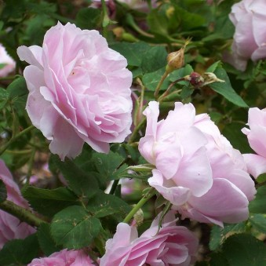
Queen of Bourbons (Bourbon Queen) Bourbon (Mauget, 1834). Very fragrant cupped blooms in shades of magenta and pink, with some repeat. Tolerant of shade and poor soils. Grows to 6 feet in height and width, or can be trained to climb. Light green foliage.

Slide 25
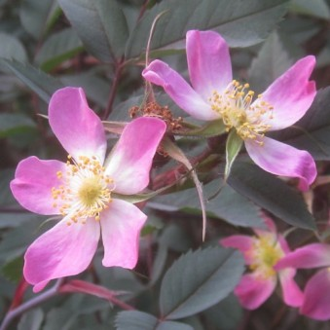
Rosa glauca (Red Leaf Rose) Species Rose (1830). Starry, single pink flowers in spring are complemented by plum colored foliage. Orange hips remain on the bush through fall and winter. A very hardy, drought resistant shrub with graceful red canes 7 to 9 feet tall.

Slide 26
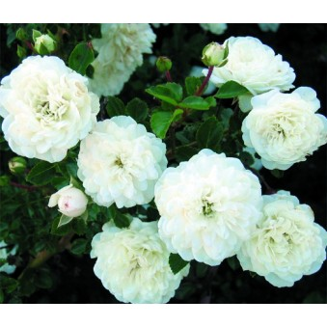
Sea Foam Shrub (Schwartz, 1964). Clusters of blush-pink buds open to double white blooms. Glossy foliage on a trailing bush. "Earth-Kind Rose".

Slide 27
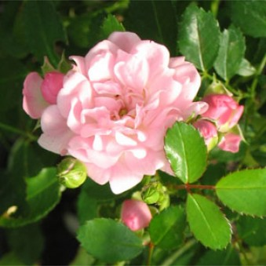
The Fairy Polyantha (Bentall, 1932). The vigorous, low-growing dense habit of this rose makes it an excellent ground cover or container plant. Covered with sprays of frilly double pink flowers all summer. Foliage is glossy green. Height & spread 2 1/2 ft.

Slide 28
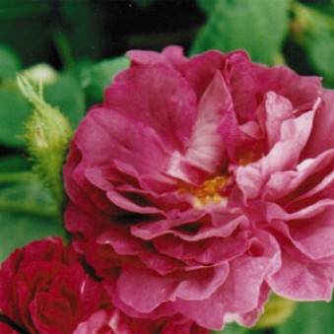
William Lobb (Old Velvet Moss) Moss (Laffay, 1855). Large, crimson-purple blooms with a lighter lilac-pink reverse cover the bush in mid-summer. The buds are heavily mossed and pine scented. Vigorous, prickly growth to a height of 6 feet.

Slide 29
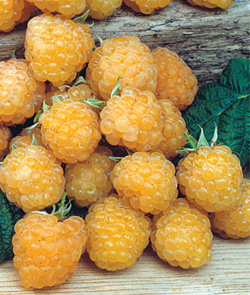
“Anne” Yellow Raspberry Rubus idaeus "Anne" A primocane raspberry. Arching canes produce large, sweet yellow raspberries on the current year's growth, making it ideal for areas where raspberries winter kill. Mow old canes with lawnmower in early-spring. Yellow fruits are less attractive to birds than red. Mature Height: 4-5’ Mature Spread: 1-3’ Exposure: Sun Water Requirements: Medium

Slide 30
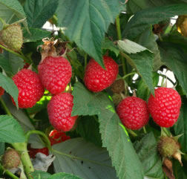
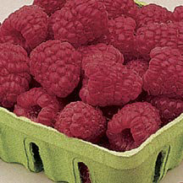
“Caroline” Red Raspberry Rubus idaeus "Caroline" A primocane raspberry. Arching canes produce large, tangy-sweet red raspberries on the current year's growth, making it ideal for areas where raspberries winter kill. Mow old canes with lawnmower in spring before canes green up. Heavy producer. Mature Height: 4-5’ Mature Spread: 2’ Exposure: Sun Water Requirements: Medium

Slide 31
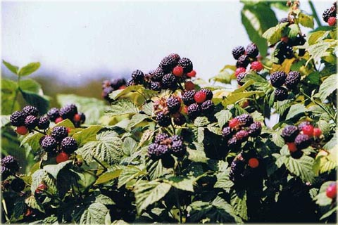
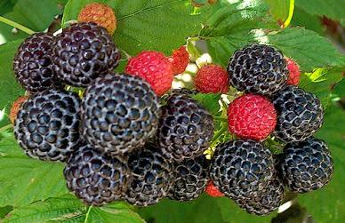
“Bristol” Black Raspberry Rubus occidentalis "Bristol" Large clusters of black fruits are produced on last year's wood in early summer from small white blooms. Dark green leaves and barbed canes form a prickly thicket. Mature Height: 3-4’ Mature Spread: 1-3’ Exposure: Sun Water Requirements: Medium

Slide 32
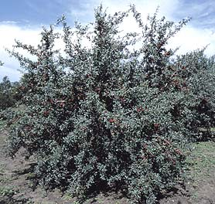
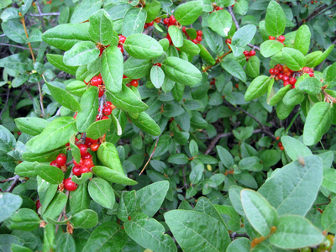
Silver Buffaloberry Shepherdia argenta A native shrub-small tree with stiff, spreading branches with stout spurs that create a dense, upright crown. Often forms thickets. Tiny, yellowish-white flowers over oval, silver-green leaves. Bright red, pea-sized fruit on female plants in late summer make great jams and jellies. Mature Height: 8-15’ Mature Spread: 6-12’ Exposure: Sun Water Requirements: Very Low

Slide 33
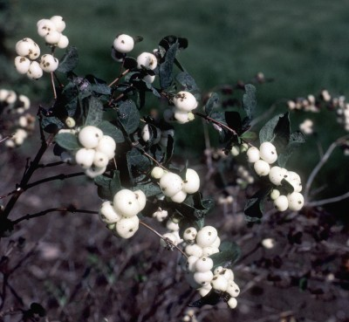
White Snowberry Symphoricarpos albus Conspicuous large, white berries in autumn. Good in half shade and moist locations. Dainty, pink flowers in July. Excellent for holding soil on steep banks. Good wildlife habitat. Zones 3-7 Mature Size: 5-6’H x 3-6’

Slide 34
La Crescent Grape Vitis “La Crescent" Makes superior quality off-dry or sweet white wines reminiscent of Vignoles or Riesling. It has an intense nose of apricot, peach and citrus with high acidity that provides good structure for excellent dessert or late-harvest style wines. Fruit ripens September. Developed in Minnesota. Fully cold hardy. Mature Height: Vine Mature Spread: Vine Exposure: Sun Water Requirements: Medium

Slide 35
St. Theresa Seedless Grape Vitis "St. Theresa Seedless" Large, heavy vine with typical grape leaves and tendrils. Large, sweet, purple grapes are great for fresh eating, jams, or sweet wines. Fully cold hardy. Mature Height: Vine Mature Spread: Vine Exposure: Sun Water Requirements: Medium

Slide 36
Trees

Slide 37
Korean Maple Acer pseudosieboldianum For those of us in northern climates, there is finally an alternative to Japanese maples (Acer palmatum). Korean maples are similar enough that we can happily fool ourselves with this hardier substitute. A showy accent plant with palmate leaves, brilliant autumn colors and attractive bark. Prefers cool conditions and will like partial shade. Great as an understory tree. Leaves can scorch in full sun here in Wyoming. Dark green foliage. Rounded shape. Yellow to red to orange fall color. Zones 4-7 Mature Size: 15’H x 10’

Slide 38
Tatarian Maple, var. Hot Wings Acer tatarian ‘Gar Ann’ The perfect maple when you don’t have room for a 50-100’ tree. The habit is graceful, upright and spreading. The little yellow flowers are followed by bright red samaras, hence the name ‘Hot Wings.’ The dark green foliage turns yellow to red giving the fall color expected from a maple. Tolerant of alkalinity and dry conditions. A Colorado Plant Select introduction. Oval, irregular shape. Dark green foliage. Yellow to red fall color. Zones 3-6 Mature Size: 20-25’ H x 18-20’

Slide 39
River Birch Betula nigra This river bottom native also does well on upland soils. Resistant to bronze birch borer, it has nice yellow fall color, and attractive cinnamon-brown exfoliating bark for an interesting winter effect. Oval shape. Dark green foliage. Golden yellow fall color. Zones 4-8 Mature Size: 40-50’H x 30-40’

Slide 40
Showy Mountain Ash Sorbus decora This smaller ornamental tree is grown for its white flowers, handsome foliage, and showy red fruit. The hardiest of the species in this country, it is slow growing and resistant to disease. Own root. Rounded shape. Dark green foliage. Red fall color. Zones 2-6 Mature Size: 20-25’H x 20’

Slide 41
Burr Oak Quercus macrocarpa This sturdy oak is a highlight in any landscape. It has a striking charcoal gray, deeply ridged bark and the golf ball sized acorns have an attractive fringed texture. It’s a fall showstopper in brilliant gold, red-orange and red. Zones 3-8 Mature Size: 30-50’H x 30-50’

