Slide 1
Herbaceous Perennials for the 2014 Plant Sale

Slide 2
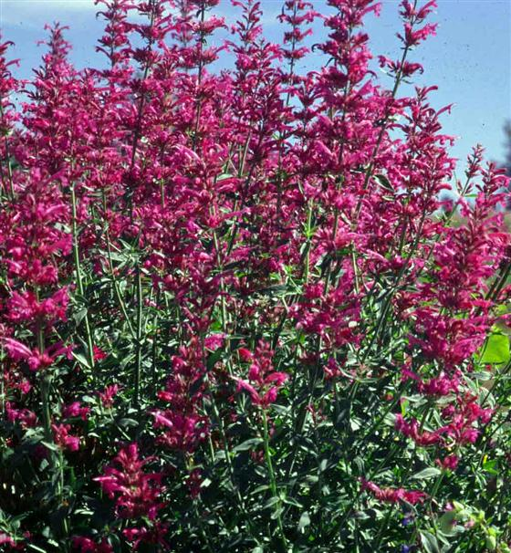
Sonoran Sunset Hyssop Agastache cana ‘Sonoran Sunset' A compact form of the double bubble mint with aromatic, textured foliage on rigid, branched stems. Produces loose spikes of rich pink tubular flowers with a bubble gum fragrance. Blooms mid-summer to fall. Mature Height: 15” Mature Spread: 12-15" Exposure: Sun Water Requirements: Low

Slide 3
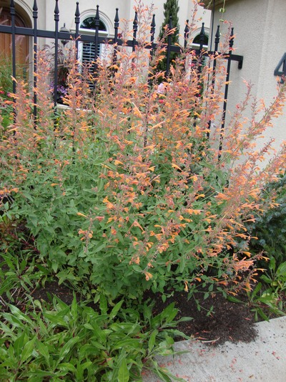
Coronado Hyssop Agastache aurantiaca ‘Coronado' Large numbers of curved, pale orange flowers from midsummer to autumn frost. This silvery-leaved southwestern wildflower with slim, branched stems has an intensely minty fragrance when handled or crushed. Sunny, well drained sites. Mature Height: 15-18” Mature Spread: 12-15" Exposure: Sun Water Requirements: Low

Slide 4
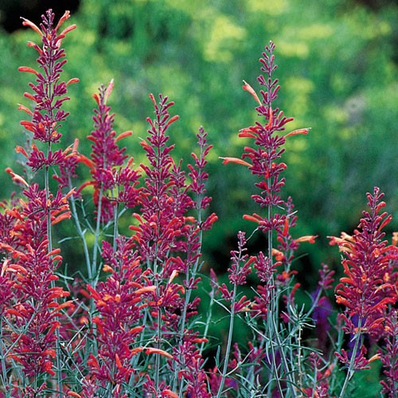
Sunset Hyssop Agastache rupestris Bold spikes of sunset-orange flowers from August to frost with a wonderful root beer aroma, thrives in a hot dry climate. Also called licorice mint. Hummingbird magnet. Mature Height: 2-3’ Mature Spread: 2-3’ Exposure: Sun Water Requirements: Low

Slide 5
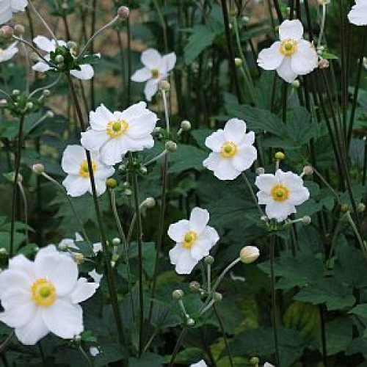
Anemone x hybrida 'Honorine Jobert‘ Anenome Substantial mounds of large leaves are palmately compound with three lobes. The long branching stems are topped in fall by 2 to 3" single white blooms with 7 to 9 petals each. Excellent for cutting. Mature Height: 30-36” Mature Spread: 30-36" Exposure: Filtered Shade Water Requirements: Medium

Slide 6
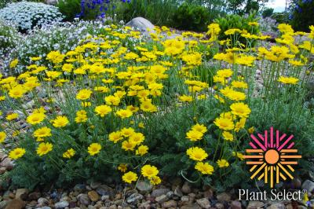
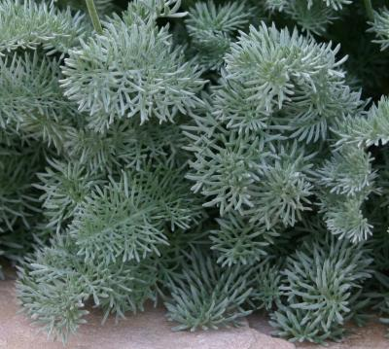
Filigree Daisy Anthemis marschalliana A low mound with fuzzy, finely dissected, silvery-gray leaves, and yellow daisy-like flowers on erect stems. Blooms early summer. Xeric. Mature Height: 12-15” Mature Spread: 12-15” Exposure: Sun Water Requirements: Low

Slide 7
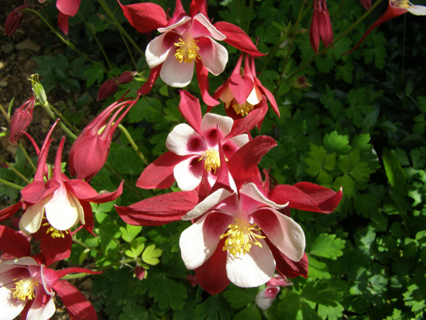
Aquilegia 'Crimson Star' Crimson Star Columbine Flowers have red sepals and white petals with a red basal spot and long red spurs. Foliage forms erect clumps on branching stems.. Mature Height: 24-30” Mature Spread: 24-30” Exposure: Filtered Shade Water Requirements: Medium

Slide 8
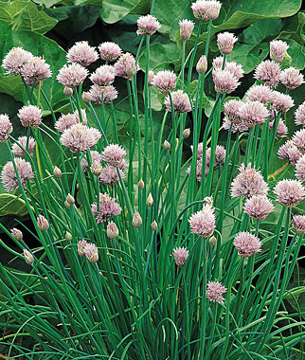
Allium schoenoprasum Chives Flowers have red sepals and white petals with a red basal spot and long red spurs. Foliage forms erect clumps on branching stems.. Mature Height: 24-30” Mature Spread: 24-30” Exposure: Filtered Shade Water Requirements: Medium

Slide 9
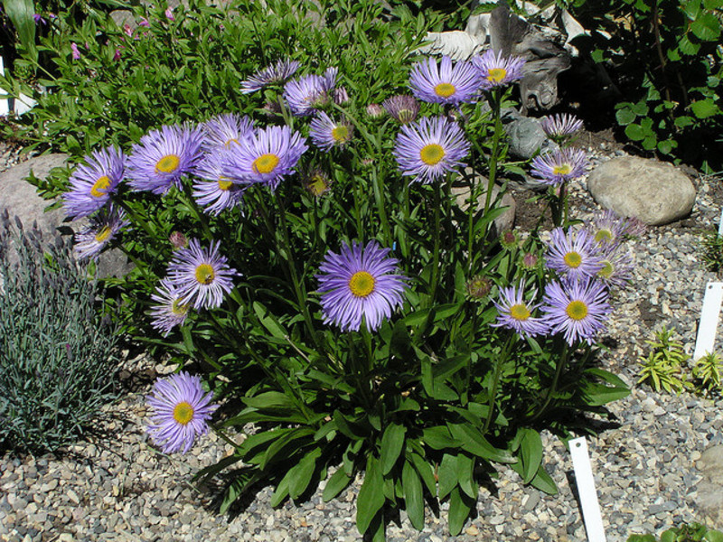
Aster alpinus 'Goliath' Goliath Alpine Aster Lavender daisy-like flowers on sturdy stems appear above a low lying clump of foliage in late spring. Displays well in rock gardens. Mature Height: 6-12” Mature Spread: 15-18” Exposure: Sun to filtered shade Water Requirements: Low

Slide 10
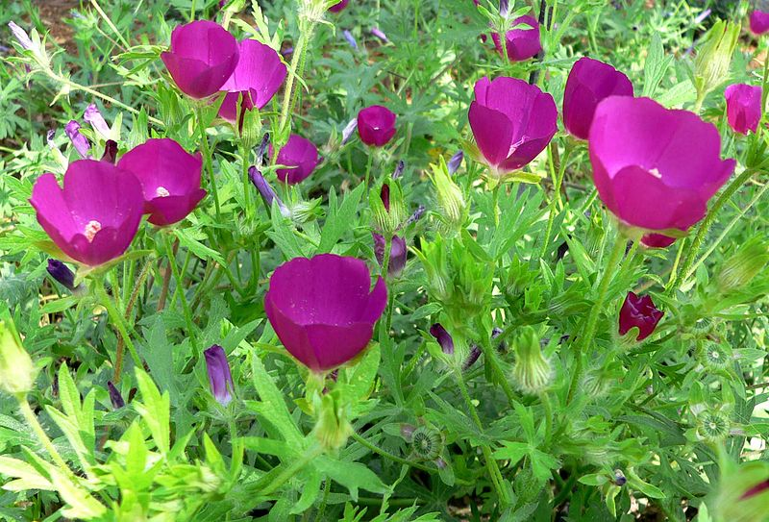
Callirhoe involucrata Prairie Winecups A low mound of trailing stems with rounded, rich green leaves and vivid, reddish-purple cup-shaped flowers. Will cascade over rocks or walls, or scramble through other plants. Mature Height: 6-12” Mature Spread: 2-3’ Exposure: Sun Water Requirements: Low

Slide 11
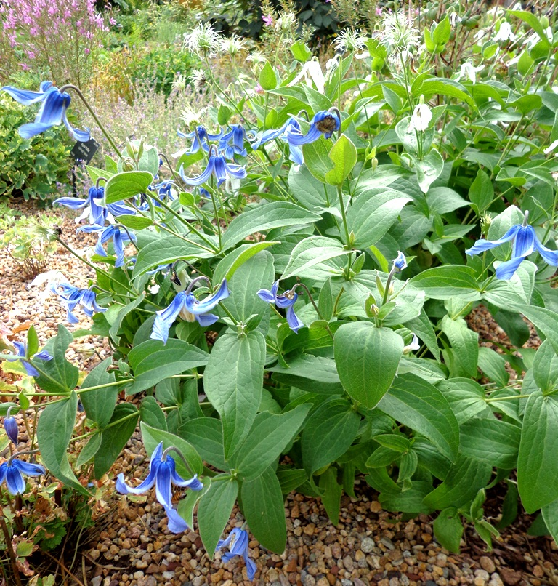
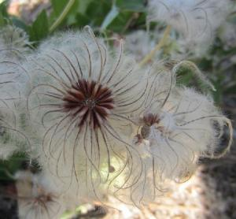
Clematis integrifolia ‘Mongolian Bells’ Bush Clematis Solitary, bell-shaped flowers ranging from white to indigo and pink appear at the ends of the stems over a compact mound of foliage from May through September. Fuzzy seed heads follow in autumn. Can be pruned hard in late winter Mature Height: 10-14” Mature Spread: 12-15" Exposure: Sun to Filtered Shade Water Requirements: Medium

Slide 12
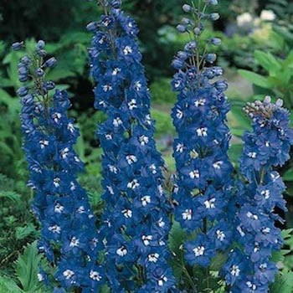
Delphinium X Pacific Giant "Blue Bird“ Blue Bird Delphinium Stout stalks rocket skyward to narrow spikes of medium blue, 3” double flowers with a white bee. Deeply divided, rich green leaves form a heavy clump. Mature Height: 3-5’ Mature Spread: 2-3’ Exposure: Sun Water Requirements: Medium

Slide 13
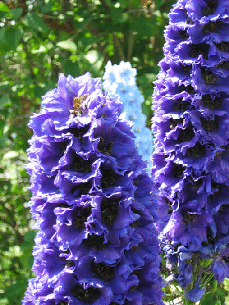
Delphinium X Pacific Giant ‘Black Knight’ Delphinium Tightly packed racemes of midnight blue 3” double flowers with black bees in long, slender spikes rise from a large clump of deeply cut maple-like leaves. Mature Height: 3-5’ Mature Spread: 2-3’ Exposure: Sun Water Requirements: Medium

Slide 14
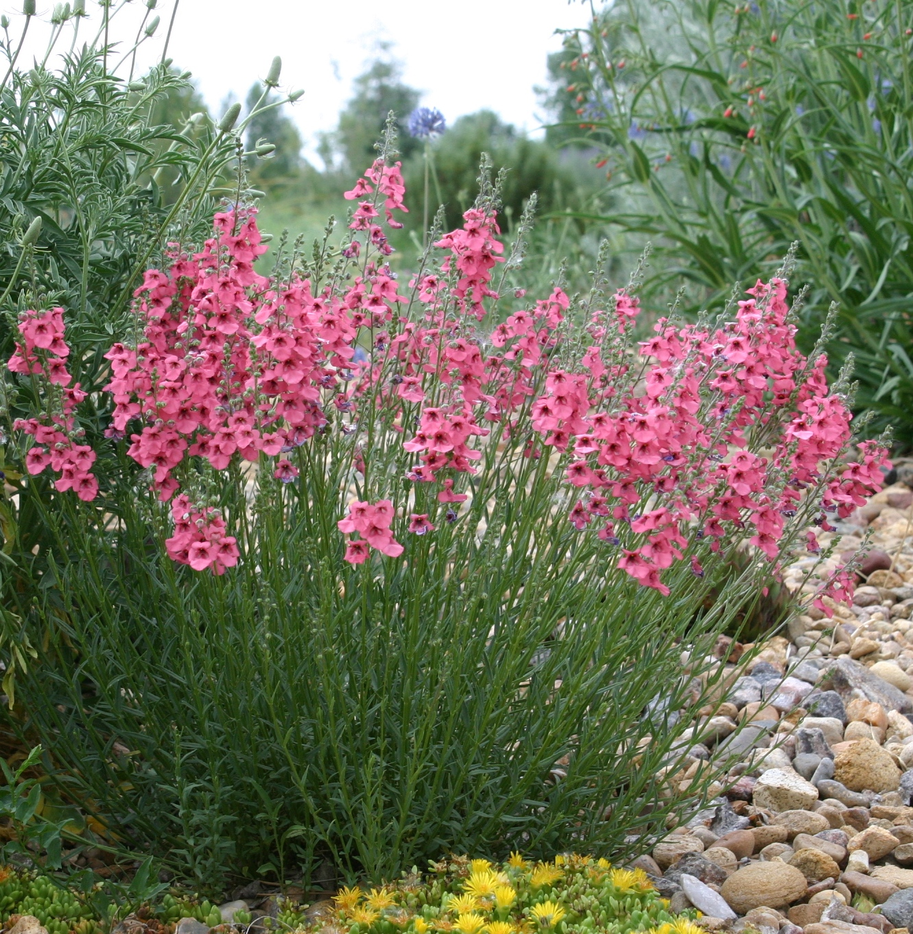
Coral Canyon Twinspur Diascia integerrima "Coral Canyon" Soft pink, oval-shaped flowers form a cloud over the plant. Blooms all summer. Mature Height: 15” Mature Spread: 12” Exposure: Sun Water Requirements: Moderate

Slide 15
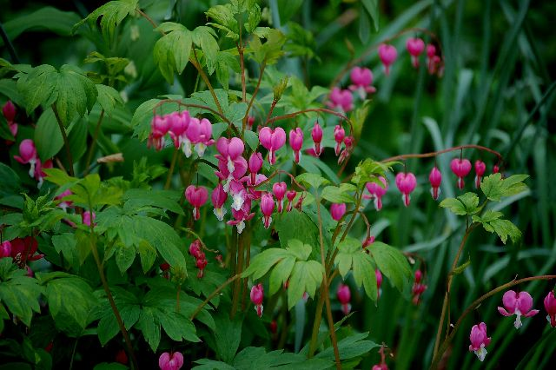
Old-Fashioned Bleeding Heart Dicentra spectabilis Arching stems of nodding, pink heart-shaped flowers in late spring to early summer over a clump of deeply cut, rich green foliage. Mature Height: 2-3’ Mature Spread: 18-24” Exposure: Shade Water Requirements: Moderate

Slide 16
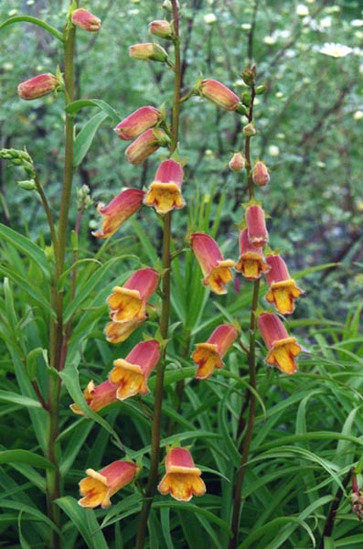
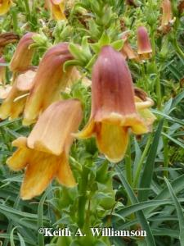
Sunset Foxglove Digitalis obscura Willow-like, narrow leaves, erect stems with spikes of dark orange, tubular flowers with spotted throats arranged on one side of the flower stalk. Mature Height: 14-24” Mature Spread: 15-20” Exposure: Sun Water Requirements: Moderate

Slide 17
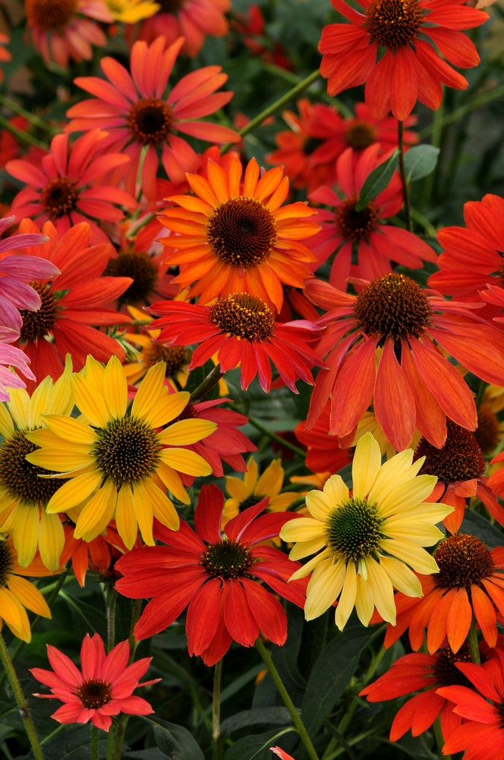
‘Cheyenne Spirit’ Coneflower Echinacea 'Cheyenne Spirit' A compact, well-branched perennial hybrid. Dark green leaves in a basal clump and along the stems. Large, fragrant, showy flowers bloom in their first year in a mix of colors including red, scarlet, orange, purple, yellow, cream and white. Mature Height: 18-30” Mature Spread: 10*20” Exposure: Sun Water Requirements: Moderate

Slide 18
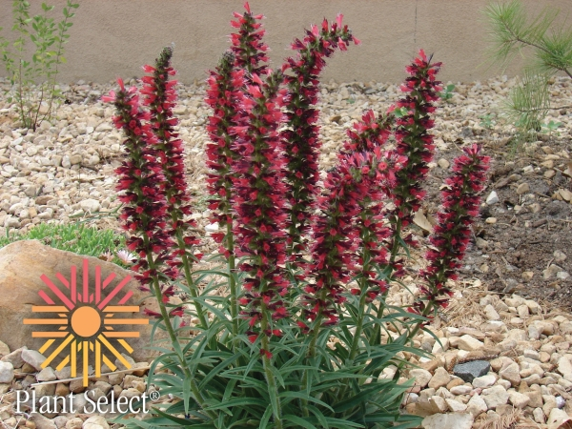
Red Feather Bugloss Echium amoenum "Red Feathers“ Upright, leafy stalks ending in spikes of rusty-red blooms grow from a crown of foliage from spring through summer. Mature Height: 12-20” Mature Spread: 12-15” Exposure: Sun Water Requirements: Low

Slide 19
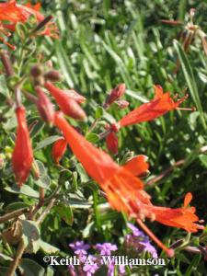
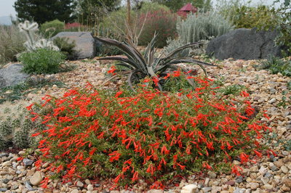
Orange Carpet Hummingbird Trumpet Epilobium canum garettii "Orange Carpet“ (Zauschneria garrettii) Outstanding performer. Bright orange-red tubular flowers in late summer to fall on slender, hairy stems with light-green leaves. Will cascade over rocks and walls. Hummingbirds love it! Mature Height: 6” Mature Spread: 15-24” Exposure: Sun Water Requirements: Low

Slide 20
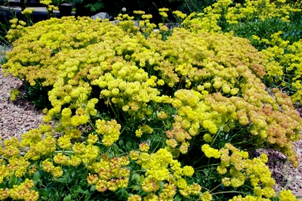
KANNAH CREEK® Buckwheat Eriogonum umbellatum var. aureum ‘Psdowns’ Leaves dark green with white undersides, grows in matting rosettes and turns a rich red color in the fall and winter. Thin stalks form umbrella-like clusters of bright yellow flowers in summer which turn orange as they age. Mature Height: 6-12” Mature Spread: 12-24” Exposure: Sun Water Requirements: Very Low

Slide 21
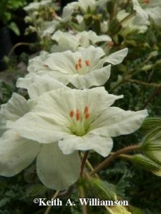
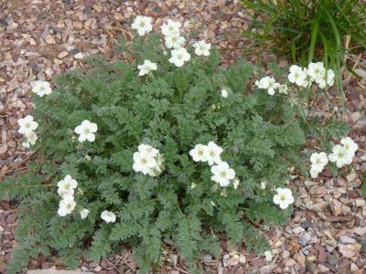
Golden Storksbill Erodium chrysanthum A low mound of gray-green, fern-like foliage forms a backdrop for the fragrant, soft yellow, geranium-like flowers from early spring until late summer. Mature Height: 8-10” Mature Spread: 10-25” Exposure: Sun Water Requirements: Low

Slide 22
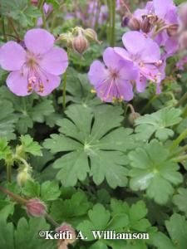
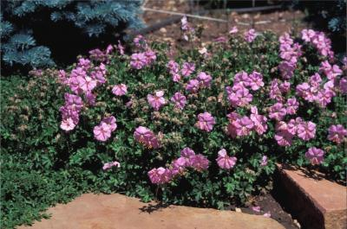
Dalmatian Pink Cranesbill Geranium dalmaticum Low-growing diminutive geranium with early summer pink flowers. Glossy green, aromatic leaves turn red in fall. Excellent choice for small spaces, rock gardens and permanent containers. Mature Height: 4-6” Mature Spread: 12-18” Exposure: Sun to part sun Water Requirements: Moderate

Slide 23
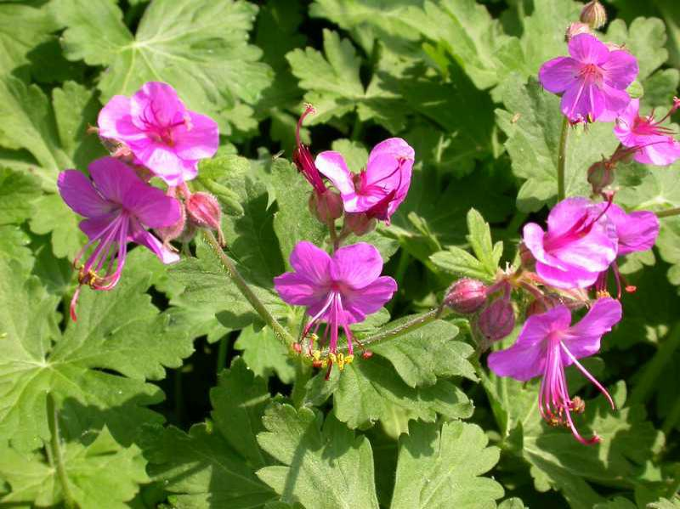
Adriatic Cranesbill Geranium macrorrhizum Creeping rhizomes give rise to dense, bushy stems with aromatic leaves. Clusters of magenta blossoms appear above the foliage from mid-spring to early summer. Mature Height: 12-15” Mature Spread: 18-24” Exposure: Shade Water Requirements: Low

Slide 24
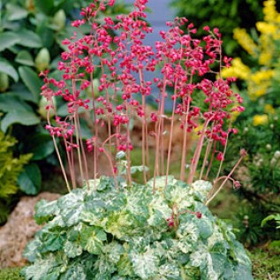
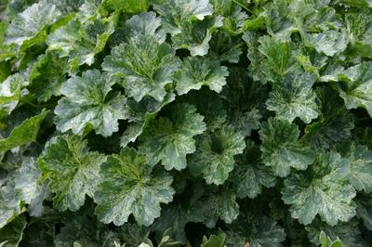
“Snow Angel” Coral Bells Heuchera sanguinea "Snow Angel" Rounded, broadly lobed leaves with creamy variegation form tidy clumps. Slender spikes of dainty pinkish-red or coral flowers bloom above the foliage from late spring into summer. Mature Height: 12-18” Mature Spread: 10-15” Exposure: Sun to part sun Water Requirements: Moderate

Slide 25
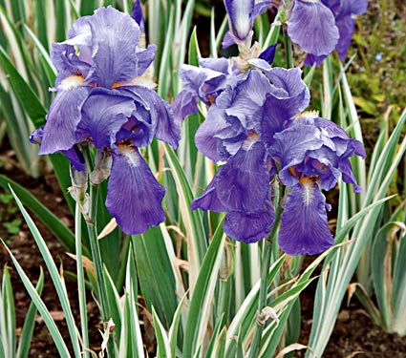
Cream Variegated Iris Iris pallida 'Argentea Variegata" Long, linear leaves are vertically striped with cream bands. Large grape-scented, lavender blossoms are held above the foliage on strong stems in late spring. Mature Ht: 2-3’ Mature Spread: 12-18” Exposure: Part Shade Water Requirements: Low

Slide 26
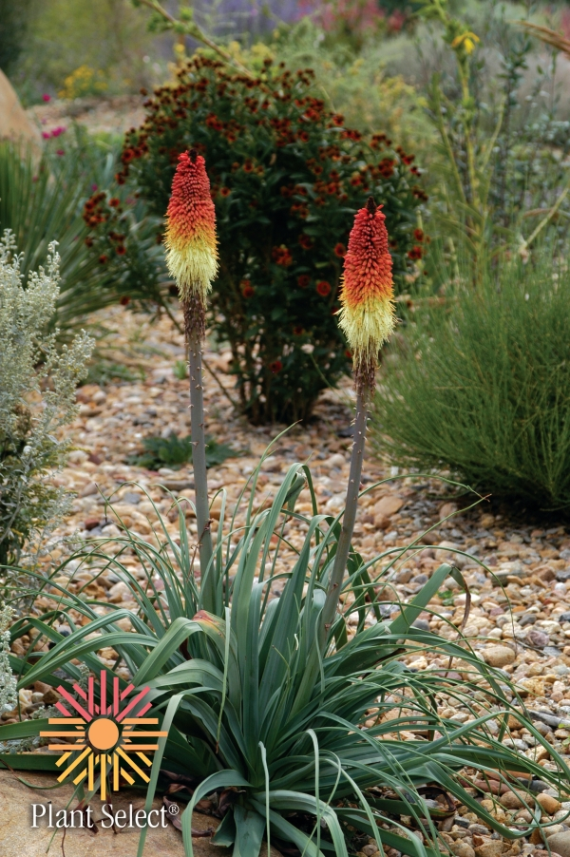
Regal Torch Lily Kniphofia caulescens Rich, blue, narrow grass-like foliage in thick clumps. Spikes of flowers are composed of tubular florets in coral, fading to yellow, and open from the bottom of the spike upwards. A hummingbird magnet in mid to late summer. Mature Height: 3-4’ Mature Spread: 18-24” Exposure: Sun Water Requirements: Low

Slide 27
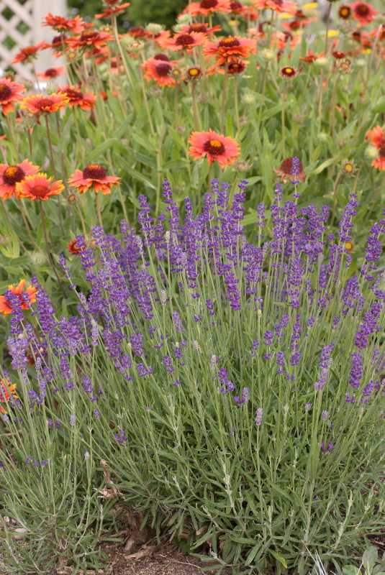
English Lavender Lavandula augustifolia "Hidcote" Thin spikes of dark purple-violet flowers above needle-like, silvery foliage. Very aromatic. Keep crowns of plants dry to prevent crown rot. Mature Height: 8-12” Mature Spread: 8-12” Exposure: Sun Water Requirements: Low

Slide 28
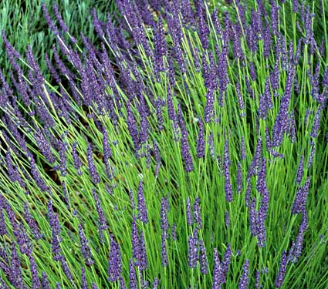
Grosso Lavender Lavandula x intermedia "Grosso“ Short, linear leaves on woody stems are highly aromatic. Plant forms a mounded clump topped with very fragrant, lavender-blue flowers in large, full spikes held above the foliage. Mature Height: 2-3’ Mature Spread: 2-3’ Exposure: Sun Water Requirements: Low

Slide 29
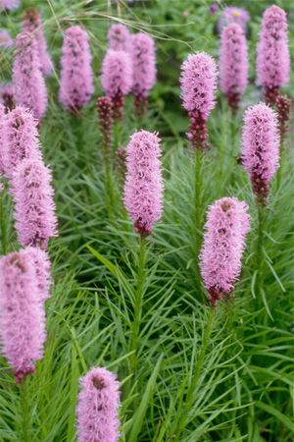
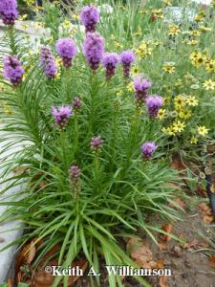
Gayfeather/Blazing Star Liatris spicata 'Floristan Violet' Whorls of pointed, linear leaves grow up a stalk that arises from a corm, topped off with a bottlebrush-shaped spike of violet-purple flowers in summer. Good for cut flowers. Mature Height: 2-3’ Mature Spread:18-24” Exposure: Sun Water Requirements: Low

Slide 30
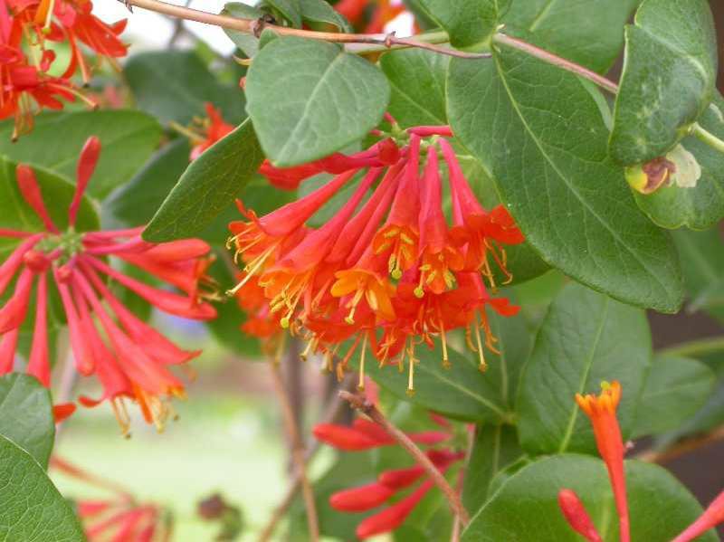
“Goldflame” Honeysuckle Lonicera x heckrottii 'Goldflame' A twining mass of woody stems covered by oval, sea green leaves producing pink fragrant tubular flowers with yellow throats flaring out with a reddish-orange blush. Mature Height: Vine 10-15’ Mature Spread: 4’ Exposure: Sun Water Requirements: Medium

Slide 31
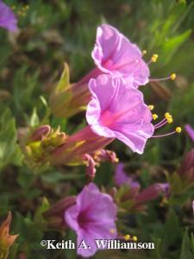
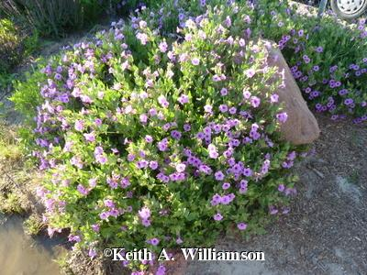
Desert Four-O'-Clock Mirabilis multiflora A wide spreading mound with rigid stems and thick, wedge-shaped, bluish-green leaves hosting large, trumpet-like, magenta flowers from mid to late summer. Do not water once established. Mature Height: 1-3’ Mature Spread: 2-4’ Exposure: Sun Water Requirements: Very Low

Slide 32
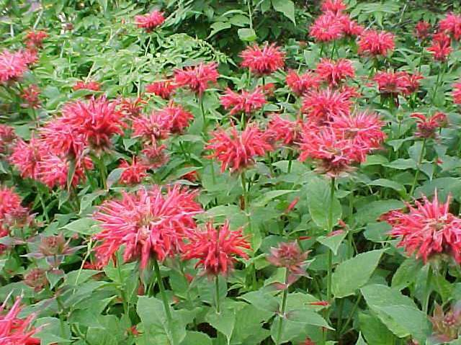
Scarlet Bee Balm Monarda 'Gardenview Scarlet' Spidery red flowers in a circular cluster on upright stalks spring from a dense clump of mint scented, rich green foliage. Attractive to hummingbirds, butterflies and bees. Mature Height: 2-3’ Mature Spread: 1-2’ Exposure: Sun to part shade Water Requirements: Medium

Slide 33
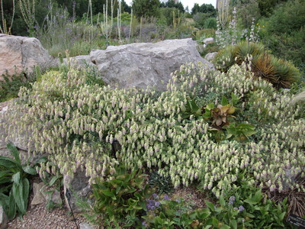
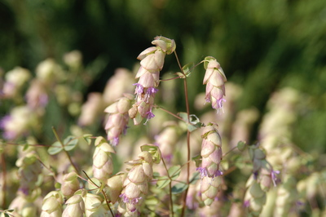
Hopflower Oregano Origanum libanoticum Vigorous, trailing herb with hop-like bracts of lavender and chartreuse through the summer months, turning brown and dry in autumn. Looks best when cascading over a raised bed, rock garden or container Mature Height: 10-15” Mature Spread: 18-24” Exposure: Sun Water Requirements: Medium

Slide 34
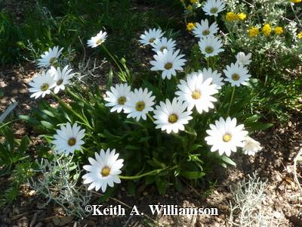
“Avalanche” White Dwarf Sun Daisy Osteospermum "Avalanche“ Nearly succulent, evergreen leaves, topped by shimmering, 3" white daisies spring-fall. Mature Height: 10-12” Mature Spread: 12-15” Exposure: Sun to part sun Water Requirements: Low

Slide 35
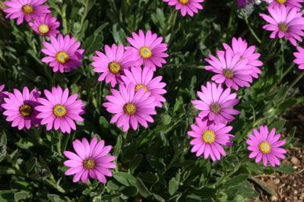
“Purple Mountain” Sun Daisy Osteospermum barberiae compactum 'Purple Mountain' This hardy daisy forms evergreen clumps of foliage that become completely covered with bright purple daisies from April through June. Mature Height: 8-10” Mature Spread: 10-12” Exposure: Sun to part sun Water Requirements: Low

Slide 36
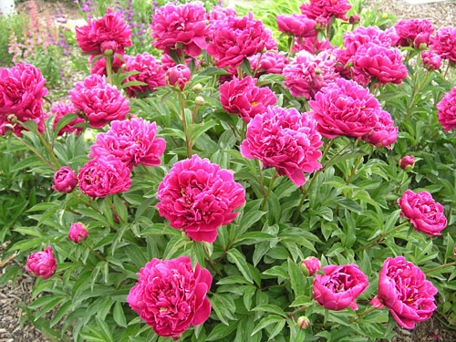
'Alexander Fleming' Peony Paeonia lactiflora 'Alexander Fleming' Large double flowers with showy pink petals, fading to paler pink around the edges, are borne in spring above a long-lived mass of rich green, divided foliage. Mature Height: 2-3’ Mature Spread: 2-3’ Exposure: Sun Water Requirements: Medium

Slide 37
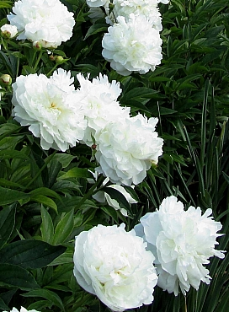
Duchesse de Nemours Peony Paeonia lactiflora "Duchesse de Nemours" Large, double cream-white fragrant flowers above a dense, rounded clump of dark green leaves. Blooms in summer. Mature Height: 2-3’ Mature Spread: 2-3’ Exposure: Sun Water Requirements: Medium

Slide 38
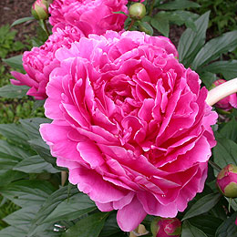
'Felix Crousse' Peony Paeonia lactiflora 'Felix Crousse' Large, double rose-red flowers cover a broad, rounded clump of thick, dark green leaves. Blooms late spring. Mature Height: 2-3’ Mature Spread: 2-3’ Exposure: Sun Water Requirements: Medium

Slide 39
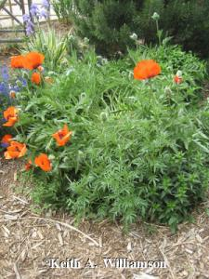
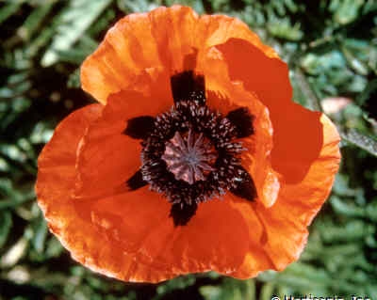
Prince of Orange Oriental Poppy Papaver orientale 'Prince of Orange' Stout stems and long leaves with coarse, bristly hairs support large, orange blossoms with crepe paper-like petals from late spring into early summer. Mature Height: 3-4’ Mature Spread: 24-30” Exposure: Sun Water Requirements: Low

Slide 40
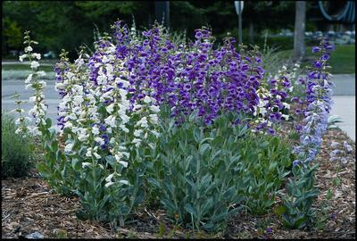
“Prairie Jewel” Penstemon Penstemon grandiflorus "Prairie Jewel“ Spikes of giant flowers ranging from pure white through lavender, rose pink, and deep purple-violet in summer. Silvery foliage rosettes are attractive all year. Mature Height: 2-3’ Mature Spread: 8-12” Exposure: Sun Water Requirements: Low

Slide 41
Grand Mesa Penstemon Penstemon mensarum Rich cobalt blue flowers with lavender throats on stout, leafy stalks above rich green glossy foliage with pointed leaves. Blooms in late spring. Evergreen foliage turns orange-red in fall. Mature Height: 24-30” Mature Spread: 10-15” Exposure: Sun Water Requirements: Moderate to Low

Slide 42
Carolyn’s Hope Beardtongue Penstemon x mexicali 'Carolyn's Hope' Narrow, glossy, dark green leaves form an attractive mound, highlighted by rosy pink blossoms produced all summer. A portion of the royalty of each plant will be donated for breast cancer research. Mature Height: 12-15” Mature Spread: 8-12” Exposure: Sun Water Requirements: Low

Slide 43
“Little Spire” Russian Sage Perovskia atriplicifolia 'Little Spire' Small, rich blue flowers circle branched spikes rising during mid- to late summer on slender, downy white stems bearing fragrant, finely cut, grayish- green leaves. Forms an open rounded shrub more upright and compact than the species. Mature Height: 2-3’ Mature Spread: 2-3’ Exposure: Sun Water Requirements: Very Low

Slide 44
Variegated Jacob's Ladder Polemonium caeruleum "Brise D'Anjou" Pinnately divided leaves, with each leaflet edged in creamy white, form striking clumps that draw immediate attention. Clusters of blue flowers are produced above the foliage in mid-spring to early summer. Mature Height: 18-24” Mature Spread: 15-18” Exposure: Shade to part shade Water Requirements: Medium

Slide 45
Pasqueflower Pulsatilla vulgaris Silvery, furry buds open to cup-shaped purple flowers with prominent yellow stamens. Attractive fuzzy seed heads. Deeply cut, lacy attractive foliage. Mature Height: 6-12” Mature Spread: 8-12” Exposure: Part shade Water Requirements: Low

Slide 46
‘Red Clock’ Pasqueflower Pulsatilla vulgaris "Red Clock" Clumps of deeply fringed leaves give rise in early spring to short stalks bearing velvety, dark red, single blossoms. Mature Height: 8-12” Mature Spread: 8-12” Exposure: Part shade Water Requirements: Low

Slide 47
Pitcher Sage Salvia azurea grandiflora A tall-grass prairie native with slender, elongated oval leaves of light green on very tall, branched stems. Produces spikes of sky blue flowers in late summer. Ideal for dry locations and background color. Mature Height: 2-4’ Mature Spread: 2-3’ Exposure: Sun Water Requirements: Low

Slide 48
Platinum Sage Salvia daghestanica ‘Platinum’ Low rosettes of silver, woolly, narrow leaves with wavy margins form a tight clump wide in well drained soils. Spikes of slender purple-blue blossoms are produced from mid-summer to fall. Mature Height: 10-12” Mature Spread: 10-12” Exposure: Sun Water Requirements: Low

Slide 49
‘Purple Rain’ Salvia Salvia verticillata "Purple Rain" Broad, arrow-shaped leaves form a backdrop for leafy, branched, arching flower stems. Purple flowers are produced in whorls over the foliage, and have pronounced whiskery stamens. Deadheading prolongs bloom period. Mature Height: 15-30” Mature Spread: 18-24” Exposure: Sun Water Requirements: Medium

Slide 50
‘Fireworks’ Goldenrod Solidago rugosa 'Fireworks' Rough-textured stems grow to 2 feet tall or more, topped in late summer with branched panicles of golden yellow flowers that give the appearance of summer fireworks. Mature Height: 2-3’ Mature Spread: 18-24” Exposure: Part shade Water Requirements: Medium

Slide 51
Silver (Wooly) Speedwell Veronica spicata incana A low clump of long-lasting silvery foliage with narrow spikes of rich blue flowers in midsummer. A good cut flower. Mature Height: 12-18” Mature Spread: 12-18” Exposure: Sun Water Requirements: Low

Slide 52
Ground Cover/Low Growers

Slide 53
‘Blue Waterfall’ Serbian Bellflower Campanula poscharskyana "Blue Waterfall" Small, medium green leaves form a low, wide-spreading groundcover that will cascade over walls and rocks. Carpets of blue, star-shaped flowers are produced from late spring to early summer, re-blooming from mid-summer through frost. Mature Height: 8-10” Mature Spread: 2-3’ Exposure: Part shade Water Requirements: Medium

Slide 54
Leadwort Ceratostigma plumbaginoides Striking cobalt-blue flowers in mid to late summer, shiny green leaves form an attractive groundcover. Turns bright red in fall. Mature Height: 8-12”Mature Spread: 18-24” Exposure: Adaptable Water Requirements: Low

Slide 55
Convallaria majalis Lilly of the Valley Thick masses of dark green, broad, oval leaves sport short stalks with dangling, bell-shaped, white flowers that are sweetly fragrant. This plant is poisonous if eaten. Mature Height: 6-12”Mature Spread: 12-15” Exposure: Shade Water Requirements: Medium

Slide 56
Delosperma floribundum "Starburst" Starburst Ice Plant Cushion-shaped plants are graced with satiny, deep pink, white-throated flowers from June through frost. Prefers full sun and needs dry winter conditions. Hardiest of all the ice plant cultivars. Mature Height: 4-6”Mature Spread: 10-12” Exposure: Sun Water Requirements: Low

Slide 57
“Silver Beacon” Spotted Dead Nettle Lamium maculatum "Silver Beacon" A thick bed of spreading silvery-white leaves with a dark green edge. Small spikes of tubular pale pink flowers in early to late spring. Lights up a shady area! Mature Height: 6-12” Mature Spread: 12-18” Exposure: Shade Water Requirements: Medium

Slide 58
Bitterroot Lewisia cotyledon 'Special Mix‘ Deep green, leathery leaves form a basal rosette. Flowers are a mix of white, pink, salmon, yellow, or orange and borne on slender stalks above the foliage in spring to summer. Needs well drained soil for best success. Mature Height: 5-8” Mature Spread: 4-8” Exposure: Sun Water Requirements: Low

Slide 59
Smokey Hills Skullcap Scutellaria resinosa "Smokey Hills" Low mats of gray-green leaves form a tight, compact groundcover. Spikes of purple, arching, hooded flowers with white lips cover the plant in late spring-early summer. Mature Height: 6-12” Mature Spread: 6-12” Exposure: Sun Water Requirements: Medium

Slide 60
“Turquoise Tails” Stonecrop Sedum sediforme "Turquoise Tails" Bright blue, burro's tail-like foliage grows in robust, compact mounds, highlighted with upright stems with bright yellow flowers in summer. A great groundcover. Mature Height: 4-6” Mature Spread: 8-12” Exposure: Sun Water Requirements: Low

Slide 61
Partridge Feather Tanacetum densum amani Grown primarily for its finely cut, silvery-white foliage, resembling a tuft of delicately curled feathers. Short stems with button-like gold flowers in midsummer. Protect crowns from excess moisture to prevent rot. Mature Height: 6-8” Mature Spread: 8-12” Exposure: Sun Water Requirements: Low

Slide 62
Turkish Speedwell Veronica liwanensis Evergreen groundcover with small, shiny rounded leaves and masses of tiny, bright blue flowers in spring. Great for between pavers and in rock gardens. Lighter blooms throughout summer. Mature Height: 2-3” Mature Spread: 15-18” Exposure: Sun to part sun Water Requirements: Low

Slide 63
"Crystal River" Speedwell Veronica "Crystal River" Hybrid between Turkish Veronica and Woolly Veronica, evergreen groundcover with small, rounded leaves. Completely covered with masses of tiny, cobalt blue flowers in spring, and blooming sporadically throughout the summer.. Mature Height: 2-3” Mature Spread: 20-30” Exposure: Sun to part sun Water Requirements: Low

Slide 64
Yellow Tufted Violet Viola cornuta 'Yellow Perfection' Lemon yellow flowers above a spreading tuft of bright green foliage bloom from spring to mid-summer. May re-bloom when cool autumn weather returns. Mature Height: 6-10” Mature Spread: 8-12” Exposure: Sun to shade Water Requirements: Moderate

Slide 65
Corsican Violets Viola corsica Prolific purple-blue violets above a tuft of rich green foliage from early spring to late summer. Reseeds. Very cute! Mature Height: 6-8” Mature Spread: 6-8” Exposure: Sun to shade Water Requirements: Moderate

Slide 66
Rocky Mountain Zinnia Zinnia grandiflora 'Gold On Blue‘ Narrow, blue-green leaves on wiry stems form a compact mound. Golden yellow flowers with orange anthers are produced throughout the summer. Ideal for xeric gardens. Mature Height: 6-8” Mature Spread:8-12” Exposure: Sun Water Requirements: Very Low

