Slide 1
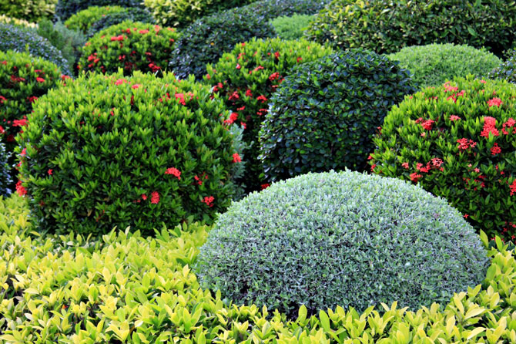
Shrubs, Bushes and Vines for the 2014 Plant Sale

Slide 2
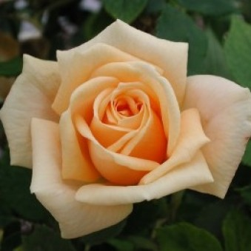
Apricot Twist Zone 4. A lovely miniature with well formed, full apricot blooms. Offers a fragrant bonus to gardeners not often found with minis. Forms a controlled miniature bush 18" to 24" tall and wide. Blooms continuously.

Slide 3
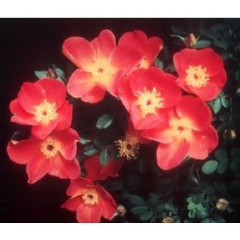
Austrian Copper Rosa foetida bicolor Zone 3. Showy, single orange flowers with yellow reverse cover this tall shrub in spring. Suckers cheerfully, making it useful for nearly impenetrable hedging. One bloom period. Mature Height: 6-8’ Mature Spread: 5-20’ Exposure: Sun Zone 3 Rebloom: None

Slide 4
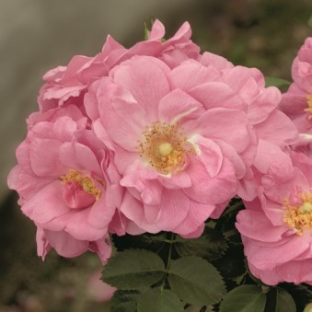
“Cape Diamond” Rose This vigorous and versatile rose may be grown as a spreading shrub or trained as a climber. Exceptionally disease resistant for black spot, rust and powdery mildew. Attractive semi-glossy foliage accentuates clusters of rounded medium pink blossoms with a unique spicy scent. Mature Height: 4-5’ Mature Spread: 3-4’ Exposure: Sun Zone 3 Rebloom: Good

Slide 5
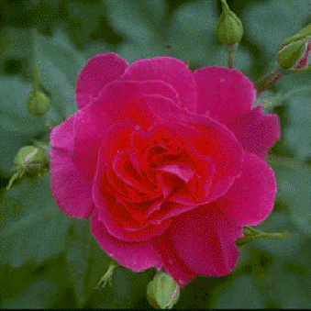
Captain Samuel Holland Shrub/Climber, Explorer Series (Ogilvie, 1991). This outstanding, winter hardy rose bears clusters of fuchsia-red double blooms continuously. It can be grown as a large shrub with canes spreading 4 to 6 feet (3-4’ wide), or trained as a handsome climber. Zone 3.

Slide 6
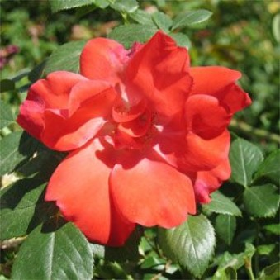
Fred Loads Floribunda (Holmes, 1968). Zone 4. This vigorous shrub is nearly always in bloom. Blossoms are 3 to 3 1/2 inches wide, semi-double, bright salmon-orange and are carried in clusters on upright stems. The shrub reaches 4 to 5 feet wide and 5 to 12 feet in height, is well branched with glossy green foliage.

Slide 7
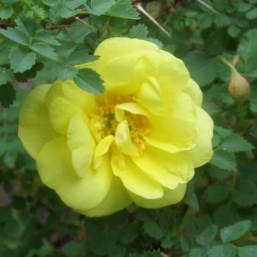
Harison's Yellow Shrub (1830). Bright yellow blooms cover arching canes in early spring. Reaching 5 to 6 feet tall and wide with ferny foliage and an upright habit, it will produce suckers and form a briar clump. One bloom period. Mature Height: 5-6’ Mature Spread: 5-6’ Exposure: Sun Zone 3 Rebloom: None

Slide 8
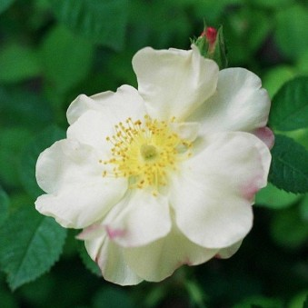
Hébé's Lip (Lee, prior to 1846) A lovely, unusual Old Garden Rose. Clusters of semi-double cream-colored blooms are edged in pink and have a rich, musky fragrance. Blooms in early summer and forms attractive red hips in fall. Mature Height: 5-6’ Mature Spread: 3-6’ Exposure: Sun Zone 4 Rebloom: None

Slide 9
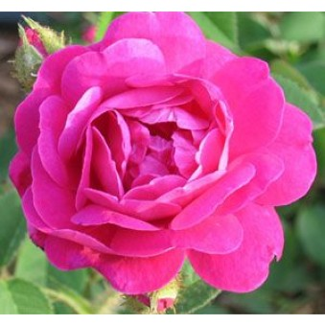
Henri Martin (Red Moss) Moss (Laffay, 1863) Heavily mossed buds open to fragrant, deep pink/red, double, 2 ½ inch blooms in mid to late season. The growth is vigorous and upright, reaching 5 feet. Mature Height: 3-5’ Mature Spread: 2-4’ Exposure: Sun Zone 4 Rebloom: None

Slide 10
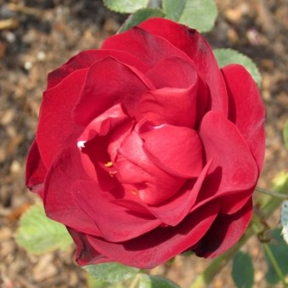
Hope For Humanity Shrub (COPF Parkland series, 1996). A hardy shrub with glossy, dark green foliage. Large clusters of deep red buds with high centers resemble small hybrid tea blooms. Repeat blooms from June until frost. Mature Height: 5-6’ Mature Spread: 3-4’ Exposure: Sun Zone 3

Slide 11
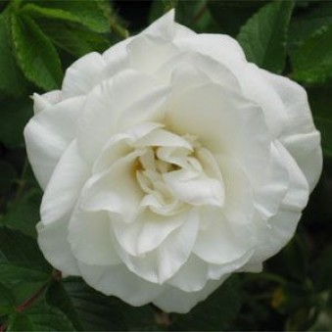
Marie Bugnet Hybrid Rugosa (Bugnet, 1963) A lovely rose with elegant pointed buds that open to fragrant, snow-white double blooms. One of the earliest to bloom in spring, repeating well into fall. The shrub is compact. Canes are a rich red in winter. Mature Height: 3-4’ Mature Spread: 3-4’ Exposure: Sun Zone 3

Slide 12
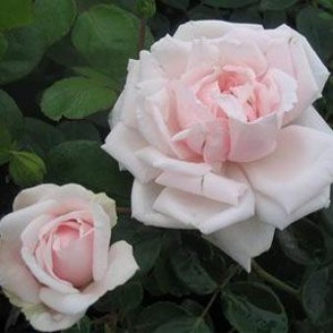
New Dawn Climber (Dreer, 1930) Silvery pink, pointed buds open to medium-size double blooms that are blush pink in some regions, but nearly white in the bright sun of higher elevations. The massive spring bloom is followed by a repeat bloom later in the season. Glossy green foliage on 10 to 15 foot canes that can either be trained to climb or left to trail. Mature Height: 10-15’ Mature Spread: 5-15’ Exposure: Sun Zone 5

Slide 13
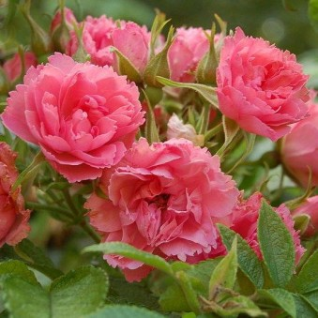
Pink Grootendorst Hybrid Rugosa (FJ Grootendorst, 1923). Clusters of clear pink, 1- inch double blooms with fringed petals repeat well on a compact, 3 to 4 foot bush with light green, crinkly foliage. Mature Height: 3-4’ Mature Spread: 3-4’ Exposure: Sun Zone 3 Rebloom: None

Slide 14
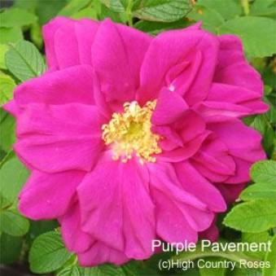
Purple Pavement (Rotes Meer) (Hybrid Rugosa, 1984). Semi-double, deep crimson-purple blooms with showy golden stamens form in fragrant clusters. Forms a dense, rounded, mound with bright green foliage and scarlet hips in autumn. The "Pavement" roses are known for their durability! Mature Height: 3-4’ Mature Spread: 2-3’ Exposure: Sun Zone 3 Rebloom: Good

Slide 15
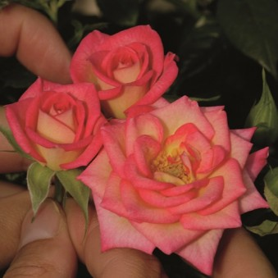
You're The One Miniature, (Bédard, United States, 2009) Miniature cream buds open into several blushing shades of pink. Deep glossy green leaves form a bushy flower filled plant covered with blossoms all season. Mature Height: 12-24” Mature Spread: 12-18” Exposure: Sun Zone 4

