Slide 1
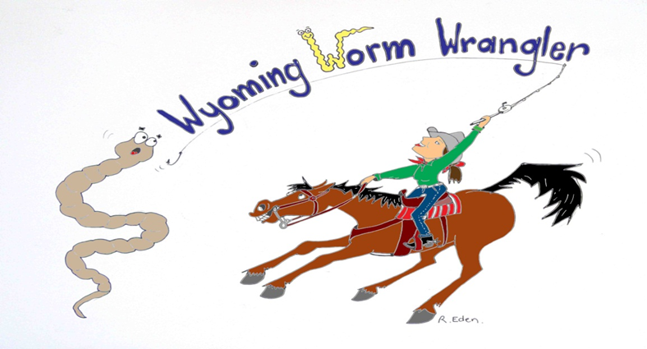
WYOMING WORM WRANGLER
ERIKA BABBITT-ROGERS
186 N Fillmore ST.
LARAMIE, WY 82070
307-760-6171
wyowormwrangler@yahoo.com

Slide 2
COMPOSTING vs. VERMICOMPOSTING
COMPOSTING:
-requires large amounts of material
-heat required for faster composting
-need to think of the C:N ratio
-must turn a compost pile
VERMICOMPOSTING:
-not limited to scale
-no heat stage required (or really wanted)
-little to no worry about C:N
-worms do most of the turning

Slide 3
SO JUST WHAT IS VERMICOMPOSTING?
Vermicomposting is a “cooler” method of composting using worms to augment the action of microbes to produce high quality compost.
Can be carried out on any scale
Can continuously add organic material with out disrupting the system
Does not require heat
Worms speed up the process
CAN BE DONE INSIDE THE HOUSE!!!!

Slide 4
WHAT DO YOU NEED TO START?
CONTAINER (plastic tubs, trenches, etc)
BEDDING (shredded newspaper and cardboard, manure *can get hot!)
WORMS (red wigglers NOT garden worms)
FOOD STUFF (anything compostable)

