Slide 1
Yard Art = YART Welcome to Laramie County Master Gardener plant Sale
Upcycling
Flea Market Finds
for your yard

Slide 2
Glue for outdoors
When you glue your plates and bowls, use GE Silicone II Clear Caulk a caulk for outdoor use.
Roughen up both side with sand paper if possible.
Clean the glass or plastics thoroughly with soap and alcohol.
Let the glue dry for 24 hours.
This caulk will dry clear, it will survive the cold, wet winter of Wyoming. You should apply pressure to the site that has been glued. You can find this caulk at Lowes

Slide 3
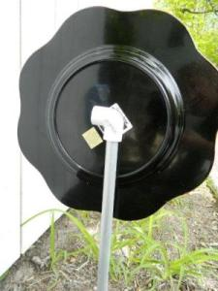
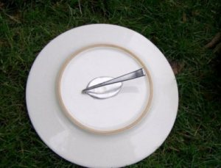
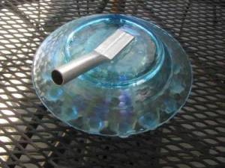
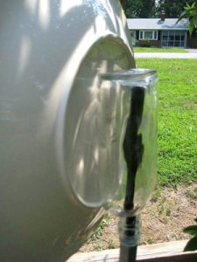
For Glass Plate Flower
For stems, use:
Aluminum pipe
Rebar rods
Wooden dowels
Copper pipe
Recycled railings
Branches
Forks & Spoons
Examples: To the left ideas how to Support the Flowers

Slide 4
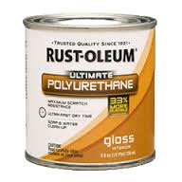
Succulent Garden Chair
Start with yard sale/flea market chair that has rattan cane seat. Remove the rattan caning.
Apply two coats of polyurethane with throw
-away brushes. To protect the chair from the weather.
Staple two layers of burlap to cover the hole in the seat in which to make a pocket to plant succulents. In these chairs there is a channel where the cane was secured. That is where the burlap should be stapled.
Because burlap is so loosely woven it is only good to plant succulents, it dries out too fast.

Slide 5
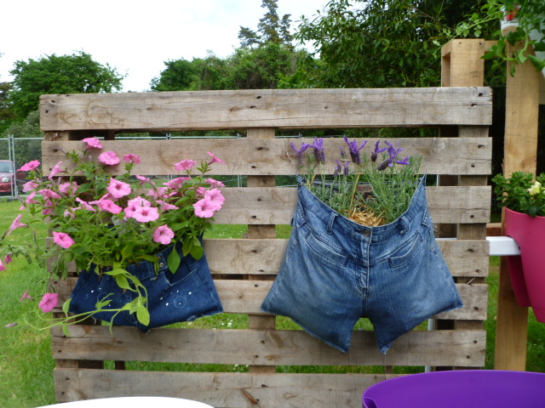
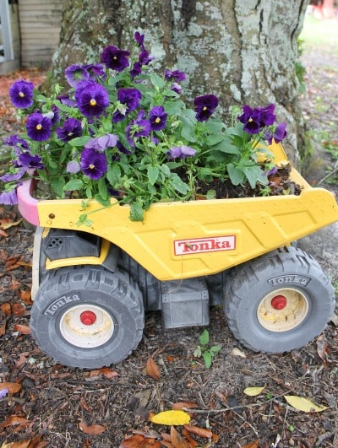
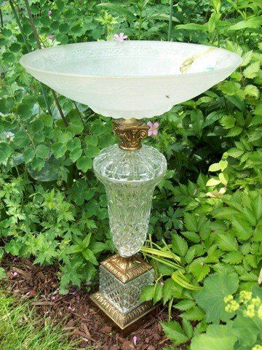
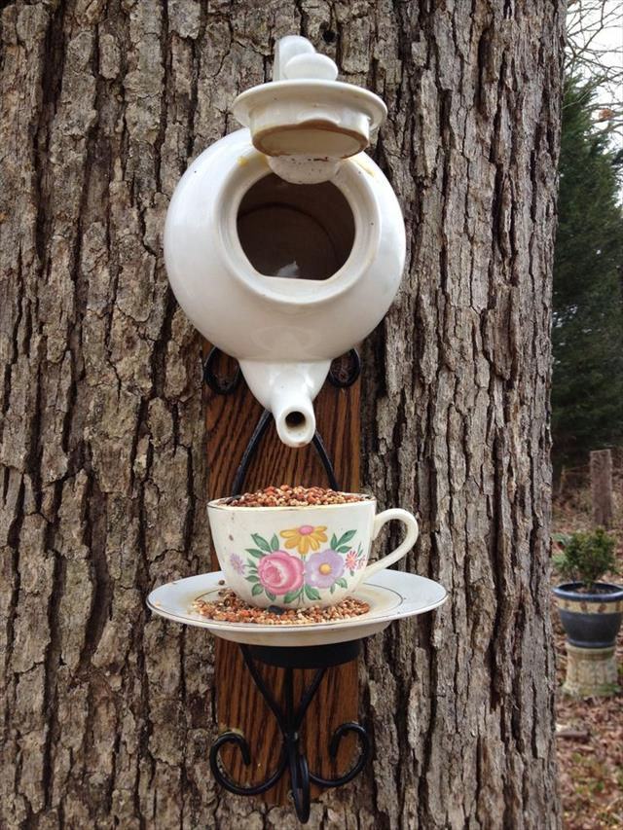
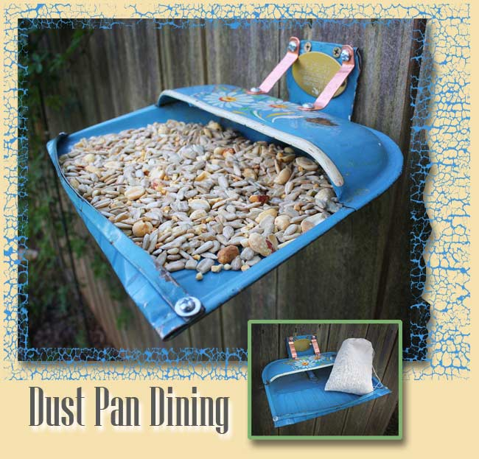
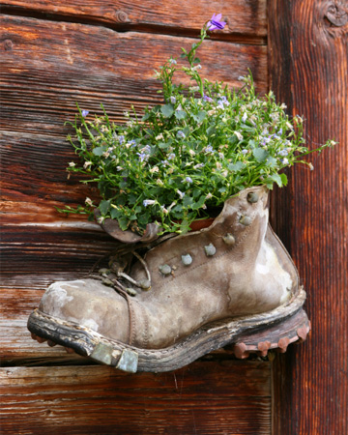
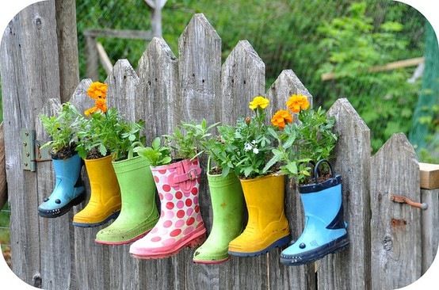
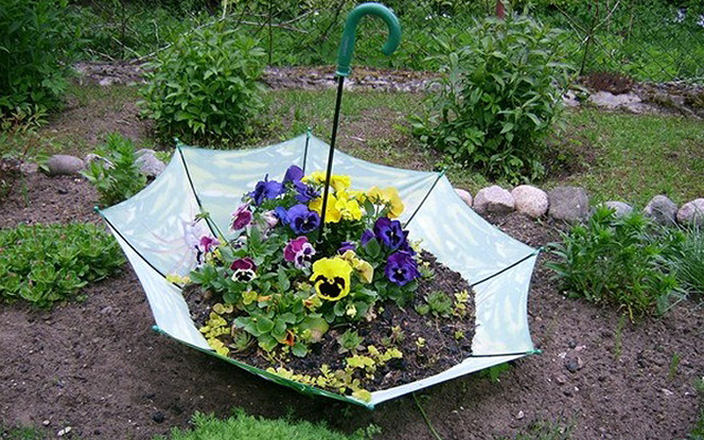
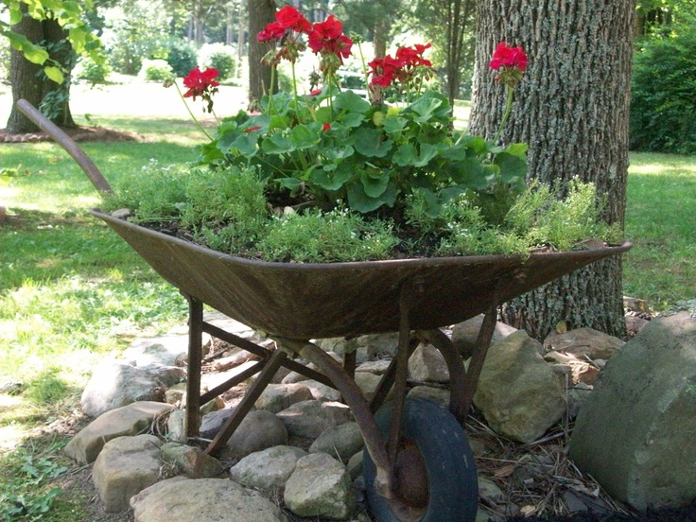
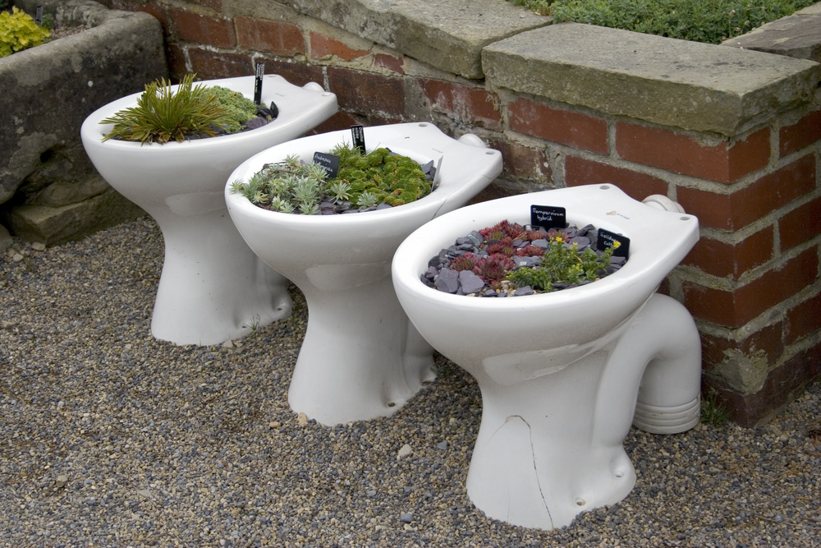
More ideas For YART
Happy Gardening

